Slide 1
George Simmel
Dr. Syed Mehdi Abbas Zaidi
Associate Professor
Department of Sociology
Shia PG College, Lucknow
Email id: mehdi.abbas92@gmail.com
Contact Number- 9839287412

Slide 2
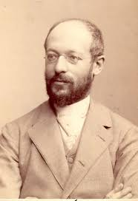
George Simmel (1 March 1858 - 28 September 1918)
Simmel was one of the first generation of German sociologists.
Simmel wrote on the topic of personal character in a manner reminiscent of the sociological 'ideal type’.
He lectured in philosophy and also in ethics, logic, pessimism, art, psychology and sociology.

Slide 3
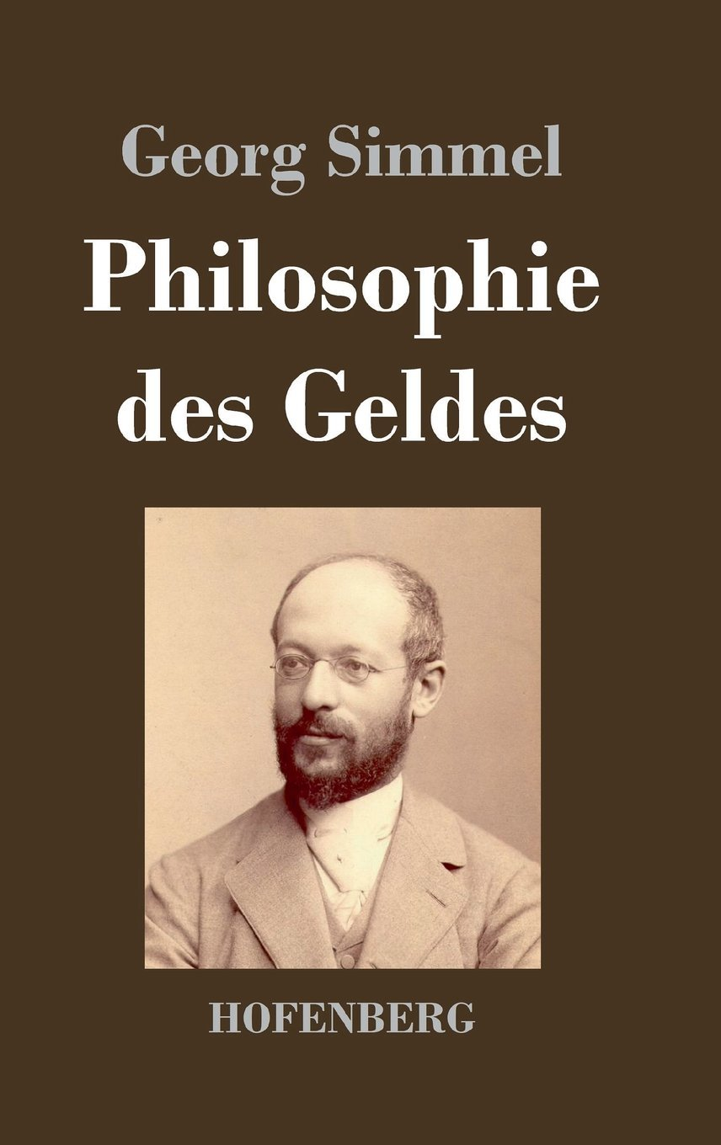
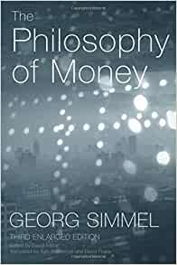
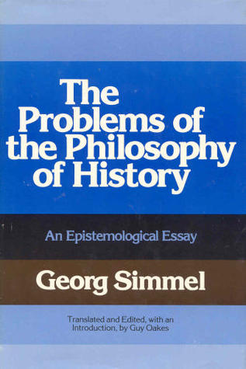
Simmel’s Major Works

Slide 4
Forms and Association
The furthest Simmel has brought his work to a micro-level of analysis was in dealing with forms and interactions that takes place with different types of people.
Such forms would include subordination, superordination, exchange, conflict and sociability.
Simmel focused on these forms of association while paying little attention to individual consciousness.
Simmel also believed that social and cultural structures come to have a life of their own.

Slide 5
Continuum
Simmel believed in the creative consciousness that can be found in diverse forms of interaction, which he observed both the ability of actors to create social structures, as well as the disastrous effects such structures had on the creativity of individuals.
Simmel refers to "all the forms of association by which a mere sum of separate individuals are made into a 'society'," whereby society is defined as a "higher unity," composed of individuals.
Simmel would especially be fascinated by man's "impulse to sociability," whereby "the solitariness of the individuals is resolved into togetherness," referring to this unity as "the free-playing, interacting interdependence of individuals.”

Slide 6
Continuum
Accordingly, he defines sociability as "the play-form of association" driven by "amicability, breeding, cordiality and attractiveness of all kinds.
In order for this free association to occur, Simmel explains, "the personalities must not emphasize themselves too individually…with too much abandon and aggressiveness.
Rather, "this world of sociability…a democracy of equals" is to be without friction so long as people blend together in the spirit of pleasure and bringing "about among themselves a pure interaction free of any disturbing material accent.

Slide 7
Social Conflict
Simmel believes that aggressive instincts are born in humans. Therefore individuals or groups find some excuse for conflict. But this is not the only reason for conflict.
Conflict usually arises due to real and significant differences in interests.
According to Simmel, conflict is always beneficial. Conflict instills perseverance in the group and empowers the common values ​​of the group.
Simmel states that external conflicts generate integration into the internal structure of the group, it acts as a 'safety valve' in the protection of the group.

Slide 8
Forms of Conflict
Simmal has given two forms of struggle:
Realistic Conflict - When conflict is a means to achieve a goal, it is called realistic conflict.
Unrealistic conflict - When conflict is self-evident (not goal oriented), it is called unrealistic conflict.

Slide 9
Consequences of Social Conflict
Simmel then turned his attention to the consequences of conflict for:
The Conflict parties
For the systemic whole in which the conflict occur.

Slide 10
1. The Conflict for Respective Parties
The more violent are inter group hostilities and the more frequent is conflict among groups, the less likely are group boundaries to disappear.
The more violent is the conflict and the less integrated is the group, the more likely is despotic centralization of conflict groups.
The more violent is the conflict, the greater will be the internal solidarity of conflict groups.

Slide 11
2. Functions of Conflict for the Systemic Whole
The less violent is the conflict between groups of different degrees of power in a system, the more likely is the conflict to have integrative consequences fro the social whole.
The more violent and the more prolonged are conflict relations between groups, the more likely is the formation of coalitions among previously unrelated groups in a system.
The prolonged is the threat of violent conflict between groups, the more enduring are the coalition of each of the conflict parties.

Slide 12
Reference
Ritzer, George- Sociological Theory
Turner J.H.- The Structure of Sociological Theory

Slide 13
Thank You

